Slide 1
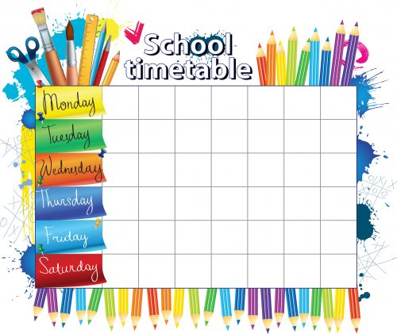
Year 10 Homework
Timetable 2017-18
History or Business Studies | Art or PE | Biology or Physics
Computer Science / Additional English | English Literature or Psychology | Revision Time
English Language | Chemistry | Triple Science / Additional English
English Language | Biology or Physics | Maths
Geography or Spanish | Maths | Revision Time

Slide 2
Year 11 Homework
Timetable 2017-18
English Language | Art or PE | Biology or Physics
Chemistry | English Language | Geography or History
Triple Science or Business Studies | Maths | Spanish or Additional English (EAL)
Maths | Biology or Physics | Revision Time
English Literature or Media Studies | Computer Science or Additional English (EAL) | Revision Time

