Slide 1
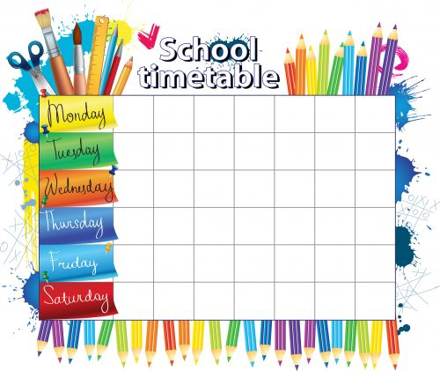
Year 7 Homework
Timetable 2017-18
History | Geography | Maths
Maths | English | Reading
Music | Spanish | Science
Maths | English | Computing
RE | Science | Art

Slide 2
Year 8 Bonitas Homework
Timetable 2017-18
Maths | PSHE | Geography
Science | Maths | English
Computing | Music | History
Art | Science | Reading
English | Religious Education | Spanish

Slide 3
Year 8 Scientia Homework
Timetable 2017-18
History | Geography | Computing
Maths | Science | English
Maths | Music | Spanish
Art | English | Reading
Religious Education | PSHE | Science

Slide 4
Year 9 Homework
Timetable 2017-18
Computing | Geography | PSHE
Art | History | Science
Maths | Music | Spanish
English | Maths | Reading
Religious Education | Science | English

